Slide 1

Multi-channel Image Acquisition in ZEN Core
APAC Digital Solutions
2021-01-21

Slide 2
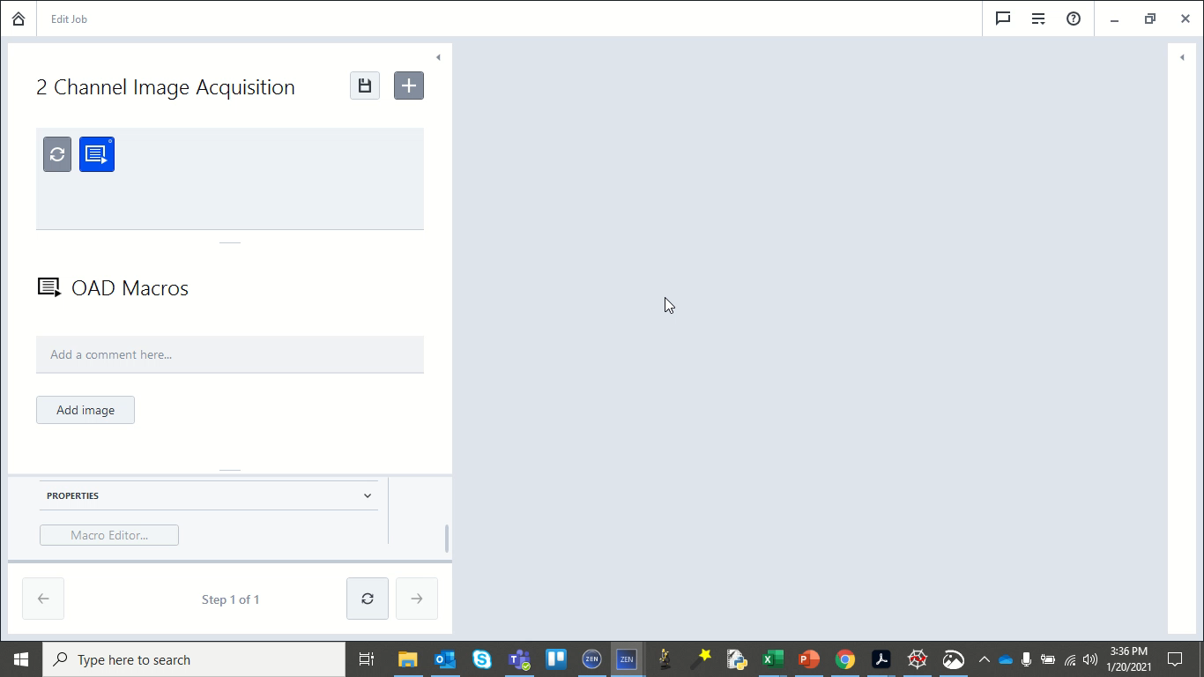
Demo video illustrating 2-channel image acquisition in ZEN Core

